Slide 1
CONTROLLING- INTRODUCTION Business Studies Class 12 UNIT -8::MODULE -1
By
ABHISHIKTH SANDEEP ABRAHAM
M.Phil, M.Com, MA(Pub.Rel & Journl), MBA (HR),B.Ed, BCJ,
ICWAI(I), PGDT, PGDCMP, Dip.Tax, CDT, UGC-NET,APSLET,
(PhD),UGC-MAN Research Fellow Awardee in Devp. Studies

Slide 2
INTRODUCTION TO CONTROLLING
CONTROLLING IS THE LAST FUNCTION OF MANAGEMENT WHICH ENSURES THAT THE ACTIVITIES BEING PERFORMED ARE AS PER PLAN
DEFINITIONS:
It refers to that managerial action which brings the actual results closer to desired (planned) results.
It is a process which seeks to bring about a conformity between actual performance and planned action

Slide 3
CHARACTERISTICS:
IT IS PERVASIVE: Applicable to all -
a) Types of Org.
b) Sizes of Org.
c) Levels of Org.
IT IS A CONTINUOUS ACTIVITY:
IT IS GOAL ORIENTED: Enhances efficiency-Helps achieve predetermined goals/results
A FUNCTION OF MANAGEMENT: -Both forward looking (looks to ensure that progress is made in the right direction to achieve goals) & backward looking (constantly makes a comparison with plan & checking for deviations (if any) and taking rectificationary action.
IT PRESUPPOSES THE EXISTENCE OF STANDARDS (which is a result of planning):
Hence planning is a prerequisite for controlling

Slide 4
ADVANTAGES OF CONTROLLING
HELPS IN BETTER PLANNING FOR THE FUTURE:
HELPS ENSURE EFFECTIVE & EFFICIENT USAGE OF ORGANIZATIONAL RESOURCES TO ACHIEVE PREDETERMINED GOALS

Slide 5
IMPORTANCE OF CONTROLLING
HELPS ACHIEVE ORGANIZATIONAL GOALS - by synchronizing performance with planned effort & keeping the progress on track
ENSURES EFFICIENT USE OF RESOURCES- Minimises wastages
MOTIVATES EMPLOYEE- Helps enhance dedication of employee to the job through a system of performance linked incentive recognition
PROMOTES ORDER & DISCIPLINE :- Checks unwanted activities
FACILITATES BETTER COORDINATION: between various departments

Slide 6
LIMITATIONS OF CONTROLLING.....
IN MOST CASES “STANDARDS” CANNOT BE ACCURATELY DEFINED IN QUANTITATIVE TERMS: Ex: In the case of attributes – Customer satisfaction, honesty of employee etc. – Hence the measurement of performance & comparison with standard is difficult.
NO CONTROL OVER EXTERNAL FACTORS : As they are beyond the control of the organization.
RESISTANCE FROM EMPLOYEES: As it seeks to constantly monitor on the job employee performance & make comparison with standards, employees feel inconvenienced and tend to offer resistance
COSTLY: Involves spending a lot of time, money & effort. It proves to be costly for small & medium enterprises

Slide 7
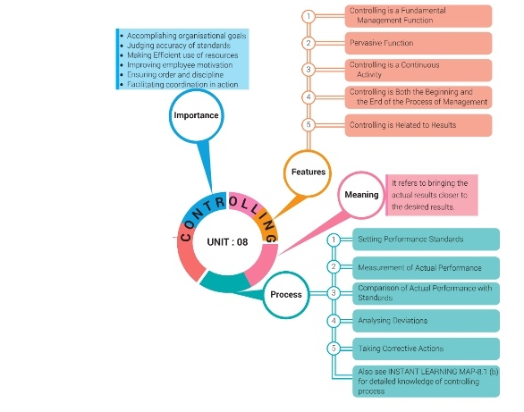
RECPITULATION
Source: Business Studies-Class 12, CBSE.
R.K.Singla.
VK Publications
Abhishikth Sandeep. A.

Slide 8
WORKSHEET
Why is controlling said to be a continous activity? ( 1 mark)
Why is it said that controlling is looking back? ( 1 mark)
“Controlling is all pervasive”- Explain. ( 3 mark)
“Controlling is an indispensible function of management”- Do you agree? Give reasons. ( 5 mark)
Name the function of management which reviews the business operations ( 1 mark)
Expalain how controlling helps in achieving the organizational goals ( 3 mark)
How does controlling ensure efficient usage of resources? ( 3 mark)
“ Controlling is forward looking “ – Explain ( 3 mark)
How does controlling improve employee morale? ( 3 mark)
Explain the importance of controlling. ( 5/6 mark)

